Slide 1
Exploring High-Dimensional Biological Data with Sparse Contrastive Principal Component Analysis
Written By: Philippe Boileau Nima S. Hejazi Sandrine Dudoit

Slide 2
Introduction
Principal component analysis (PCA) is a well-known dimensionality reduction technique but its ability to extract signal from high-dimensional data is demonstrably unstable [31, 15]. Moreover, PCA is often unable to reduce the dimensionality of the data in a contextually meaningful manner [27, 2]. Consequently, variants of PCA have been developed in attempts to overcome these severe issues, including, among many others, sparse PCA (SPCA) [41], which increases the interpretability and stability of the principal components in high dimensions by sparsifying the loadings, and contrastive PCA (cPCA) [2], which captures relevant information in the data by eliminating technical effects through comparison to a so-called background dataset. While SPCA and cPCA have both individually proven useful in resolving distinct shortcomings of PCA, neither is capable of simultaneously tackling the issues of stability, interpretability, and relevance. We propose a combination of these techniques, sparse constrastive PCA (scPCA), which draws on cPCA to remove unwanted technical effects and on SPCA for sparsification of the loadings, thereby extracting stable, interpretable, and relevant uncontaminated signal from high-dimensional biological data.

Slide 3
What is Principal Component Analysis(PCA)?
Principal Component Analysis, or PCA, is a dimensionality-reduction method that is often used to reduce the dimensionality of large data sets, by transforming a large set of variables into a smaller one that still contains most of the information in the large set.
We have a dataset composed by a set of properties from cars.
For example, think about the number of wheel as a feature of cars and buses, almost every example from both classes have four wheels, hence we can tell that this feature has a low variance ( from four up to six wheels or more in some of rare buses ), so this feature will make bus and cars look the same, but they are actually pretty different from each other. Now, consider the height as a feature, cars and buses have different values for it, the variance has a great range from the lowest car up to the highest bus. Clearly, the height of these vehicle is a good property to separate them. Recall that PCA does not take information of classes into account, it just looks at the variance of each feature because is reasonable assumes that features that present high variance are more likely to have a good split between classes.

Slide 4
cPCA
PCA is designed to explore one dataset at a time. But when multiple datasets or multiple conditions in one dataset are to be compared then the current state-of practice is to perform PCA on each dataset separately, and then manually compare the various projections.
Contrastive PCA (cPCA) is designed to fill in this gap in data exploration and visualization by automatically identifying the projections that exhibit the most interesting differences across datasets. The main advantages of cPCA are its generality and ease of use.

Slide 5

Consider a column-centered target dataset X_{n×p} and a column-centered background dataset Y_{m×p}, where n and m denote, respectively, the number of target and background observations (e.g., cells) and p denotes the number of features (e.g., genes). Denote their empirical covariance matrices by C_{X} and C_{Y} and let
be the set of unit vectors of length p (i.e., p-dimensional vectors with unit norm). The variances along direction in the target and background datasets are represented by

Slide 6
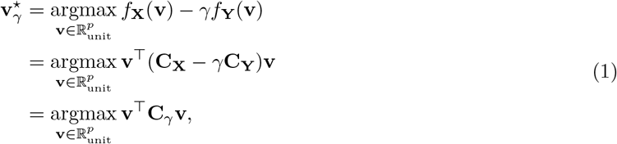
The most contrastive direction for some fixed contrastive parameter is found by solving
where C_{γ} = C_{X} − γC_{Y} is the contrastive covariance matrix [2]. cPCA can therefore be performed by computing the eigenvalue decomposition of C_{γ}. The eigenvectors of C_{γ} are then used to map the target data to the contrastive principal components (cPC).

Slide 7
Significance of γ
The contrastive parameter γ quantifies the trade-off between each feature’s variances in the target and background datasets. When γ = 0, cPCA reduces to PCA – hence, only the target variance f_{x}(v) is maximized. As γ increases, directions that reduce the background variance become more optimal and the cPCs are driven towards the null space of the background covariance matrix. In particular, as γ → ∞, the variance in the background data dominates the variance in the target data such that only directions spanned by the background dataset are captured. This is akin to projecting the target data on the null space of the background data and then performing PCA on the projected data [2]

Slide 8
Drawbacks of cPCA
No rigorous framework exists for selecting the contrastive parameter γ in order to achieve the optimal amount of contrast between the target and background data.
As with PCA, loading vectors may be highly variable and difficult to interpret in high dimensions since they represent linear combinations of all features in the dataset. Relatedly, cPCs are not certifiably free of unwanted technical and biological effects, potentially obscuring relevant biological signal. Unwanted variation can only be removed from the target data if it is also captured by the background data.
This issue is only exacerbated as the dimension of the subspace orthogonal to the background data increases, jeopardizing the stability of the cPCs and enfeebling conclusions drawn from them.

Slide 9
SPCA
In addition to being difficult to interpret, the PCs generated by applying PCA to high-dimensional data are generally unstable, that is, they are subject to major changes under minor issues of the data.
In contrast to standard PCA, SPCA generates interpretable and stable loadings in high dimensions, with most entries of the loading matrix being zero.

Slide 10

Given a matrix V_{p×k} whose columns form an orthonormal basis, the objective is to find the projection producing the best linear manifold approximation of the data X_{n×p}. This is accomplished by minimizing the mean squared error:
where x_{i} is the i^{th} row of X and is exactly the loading matrix of the first k PCs [40]. A sparse loading matrix can be obtained by imposing an elastic net constraint on a modification of this objective function.

Slide 11
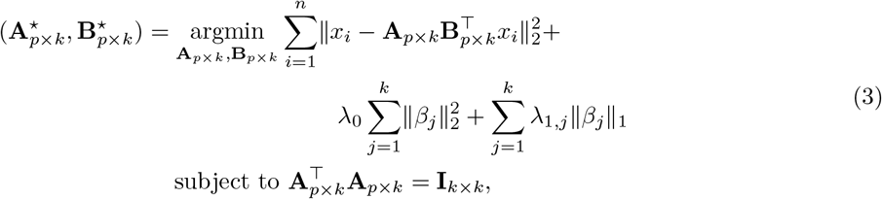
optimal β_{j} for a fixed A is equivalent to minimizing where α_{j} is the j^{th} column of A.

Slide 12
Drawbacks of SPCA
Although SPCA provides a transparent and efficient method for the sparsification of PCA’s loading matrices and hence the generation of stable principal components in high dimensions, its development stopped short of providing means by which to identify the most relevant directions of variation in the data, presenting an obstacle to its efficacious use in biological data exploration and analysis.

Slide 13
Other Competing Methods
ZINB-WaVE: Relies on a zero-inflated negative binomial model to better account for the count nature, zero inflation, and over-dispersion of scRNA-seq data, and has been shown to outperform less tailored techniques such as t-SNE [29]. Unlike more general factor analysis methods (e.g., PCA), ZINB-WaVE takes advantage of the rich annotation metadata that are often available with scRNA-seq datasets to remove sources of unwanted variation, while preserving global biological signal [29]. Analogous to PCA, the latent factors produced by ZINB-WaVE are not sparse. Other methods for reducing the dimensionality of scRNA-seq data, such as
scVI [21] and SIMLR [33]: Attempt to identify non-linear latent variables using, respectively, a variational auto-encoder framework and a similarity-learning framework relying on multi-kernel learning.

Slide 14

scPCA
The sparse contrastive PCA (scPCA) procedure applies SPCA with minimal modifications to a pair of target and background datasets’ contrastive covariance matrix C_{γ}.
For fixed A: Relying on the results of Equation (4), the elastic net solution for the j^{th} loading vector is
Generally, for ease of computation, λ_{1,j} = λ₁, for j = 1,…, k. The entries of the loading matrix B are independent of the choice for the ℓ₂ penalty (ridge) parameter λ₀ [41], which is used only for numerical reasons. The ridge penalty is set to zero when is of full rank; otherwise, a small constant value is used to remedy issues of indeterminacy that arise when fitting the elastic net.

Slide 15

Numerical Solution
For fixed B: Only the first term of the SPCA criterion of Equation (3) must be minimized with respect to A. The solution is given by the reduced rank form of the Procrustes rotation, computed as A⋆ = UV⊤ [41]. The matrices of left and right singular vectors are obtained from the following singular value decomposition:
Generally, C_{γ} is not positive-semidefinite and its square root is undefined. Instead, a positive-semidefinite matrix
, approximating C_{γ}, is used.

Slide 16

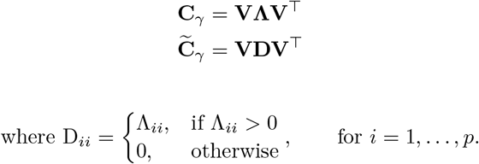
Numerical Solution
is obtained by replacing the diagonal matrix in the eigendecomposition of C_{γ} by a diagonal matrix in which negative eigenvalues are replaced by zeros [39]:
Thus, the directions of variation given by the negative eigenvalues of C_{γ} are discarded, as they correspond to those which are dominated by the variance in the background dataset.

Slide 17
Contrastive analysis
For the purpose of contrastive analysis, a direction’s importance is characterized by its target-background variance coupling; higher target variance and lower background variance pairs produce the best directions [2] and correspond to the largest positive eigenvalues. The elimination of directions with negative eigenvalues therefore guarantees that the sparse contrastive PCs (scPCs) are rotations of the target data relying on the sparse directions most variable in the target data but least variable in the background data, making a cutoff of zero a natural choice for the thresholding operation.
The scPCA algorithm relies on two hyperparameters: the contrastive parameter γ and the ℓ₁ penalty parameter λ₁. To select the optimal combination of γ and λ₁ from a grid of a priori specified values, we propose to cluster the n observations of the target dataset based on their first k scPCs, selecting as optimal the combination {γ, λ₁} producing the “strongest” cluster assignments.

Slide 18
Observation of the numerical solution
Regarding the computational complexity of scPCA (and cPCA), we note that the number of observations in the target and background data are not limiting factors. Indeed, these algorithms are applied to a p × p contrastive covariance matrix, a function of the target and background covariance matrices. The computation time of these covariance matrices increases linearly in the number of observations n and quadratically in the number of features p. The methods’ computational efficiency are therefore most impacted by the number of features and the size of the hyperparameter grid. A note on cPCA’s and scPCA’s running time is provided in Section S9, as is a comparison to competing methods.

Slide 19
Simulated scRNA-seq Data
A simple dataset of 300 cells and 500 genes was simulated such that the cells were approximately evenly distributed among three biological groups: two groups making up a target dataset and a third group corresponding to a background dataset. 5% of the genes are differentially expressed between the background dataset and each of the two target datasets but not between the two target datasets, 10% of the genes are differentially expressed between the background dataset and the first target dataset but not the second target dataset, and 10% of the genes are differentially expressed between the background dataset and the second target dataset but not the first target dataset. There is overlap between these three sets of genes and, in particular, a total of 98 genes are differentially expressed between the two target datasets. Based on these levels of differential expression, cells are more dissimilar between the two target datasets than between either of the target datasets and the background dataset. Therefore, the samples comprising the background dataset can be viewed as a set of controls for use by cPCA and scPCA. Additionally, a large batch effect was included to confound the biological variation between groups, effectively dividing each biological group into two subgroups of near equal size

Slide 20
PCA, t-SNE, UMAP, cPCA, and scPCA were applied to the log-transformed and column-centered target data, and SIMLR to the raw target data, to determine whether these methods could identify the biological signal of interest, i.e., the two groups in the target dataset (Figure 1B. Note that PCA was not included due to the similarity of results to Figure 1A and SIMLR’s embedding is included in the appendix in Figure S4). Also note that cPCA was not performed in the traditional manner of Abid et al. [2], but with automatic hyperparameter selection as described in Sections 2.2 and 1. The number of a priori specified clusters for the cPCA and scPCA methods was set to 2, and the column-centered background data were used in their contrastive steps.

Slide 21
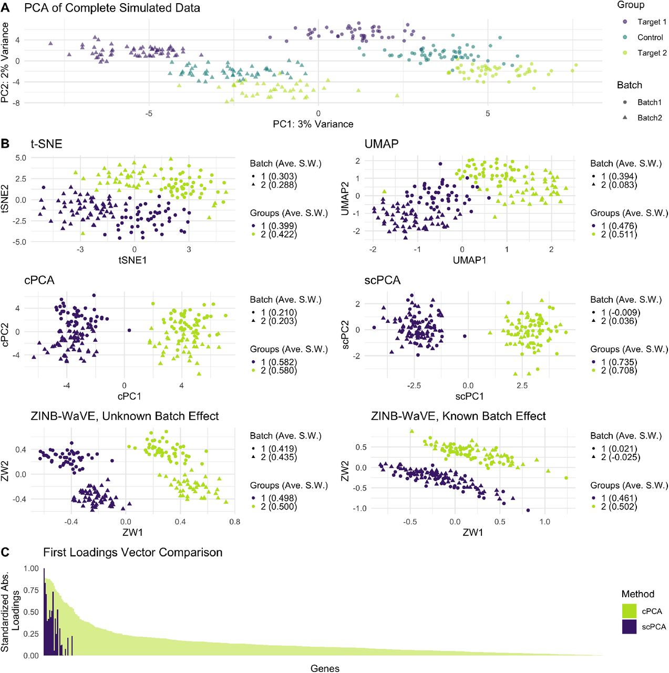
Graphical analysis

Slide 22
Observations
A Plot of the first two principal components of the complete simulated dataset (i.e., the combination of the target and background datasets). The batch effect and the biological signal are responsible for approximately identical amounts of variance.
B Two-dimensional representations of the target dataset by t-SNE, UMAP, cPCA, scPCA, and ZINB-WaVE, with accompanying average widths quantifying the strengths of the batch effect and the biological signal. Only scPCA fully removes the batch effect in two dimensions when batches are not adjusted for explicitly.
C A gene-by-gene comparison of the standardized absolute loadings in the first loading vectors of cPCA and scPCA, in decreasing order with respect to the values produced by cPCA.

Slide 23
we find the scPCA loadings to be, as expected, much sparser (see Figure 1C). In fact, only 20 genes have non-zero values in scPCA’s first loading vector compared to 500 in cPCA; moreover, these 20 genes correspond to those which have the largest absolute entries in cPCA’s first loading vector. Furthermore, these genes are among the most differentially expressed in the target dataset, based on the values of their multiplicative differential expression factors (Figure S2).
scPCA’s results were also compared to the two leading latent factors found by ZINB-WaVE, a method of choice for dimensionality reduction for scRNA-seq data, under conditions in which the batch factor is viewed as known and unknown (Figure 1B). In both cases, we find the results to be virtually identical to those of PCA. Even when the batch effect is included in the model, the clusters of the biological groups are elongated and less dense than those produced by scPCA, and the first latent factor does not linearly separate the groups.

Slide 24
3.2 Dengue Microarray Data
The target dataset consists of the log-transformed microarray expression measures of 47 patients with some form of dengue, while the background dataset consist of the log-transformed microarray expression measures of the control samples. PCA, cPCA, scPCA, t-SNE, and UMAP were then applied to the column-centered target data matrix with the goal of discerning three unique clusters (Figure 2A), one for each sub-class of dengue (DF, DHF, and convalescent). cPCA and scPCA took as additional input the column-centered background data matrix and specified three clusters a priori.

Slide 25
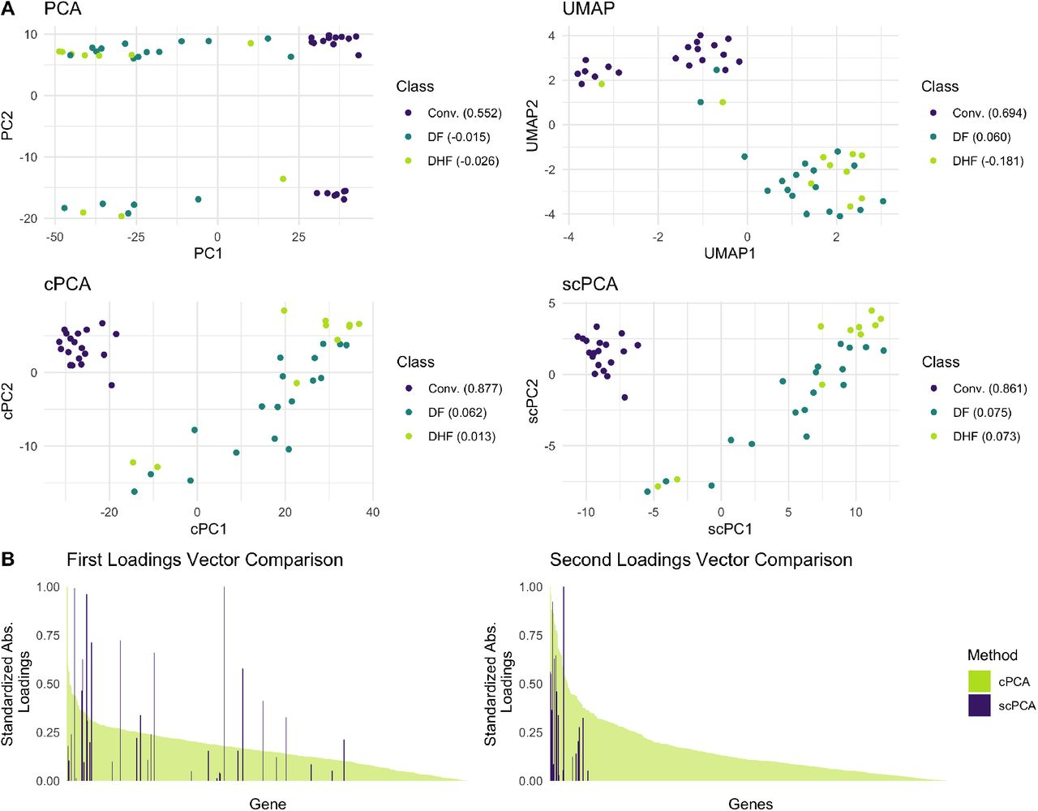
Graphical Analysis

Slide 26
Results and Observations
Of the four dimensionality reduction methods, only cPCA and scPCA successfully fully separated the convalescent patients from those with DF and DHF in two dimensions. scPCA’s low-dimensional representation was virtually identical to that of cPCA, producing very similar average silhouette widths among classes, though only a tenth of the genes have non-zero values in the first and second columns of the scPCA loading matrix, and the most important genes identified by each methods’ first loading vector differ substantially (Figure 2B). The genes found by scPCA include CD38, HLA-DQB1, and RSAD2 (Viperin), which have been previously associated to the susceptibility to, protection against, or presence of dengue [6, 5, 7]. For a full list of these genes, refer to Table S1 and Table S2. A gene set enrichment analysis (GSEA) was also performed with the genes contained in these tables to identify the most significant biological processes in which they play a role; details and results are presented in Table S3.

Slide 27
Leukemia Patient scRNA-seq Data
we tested scPCA on scRNA-seq data from the cryopreserved bone marrow mononuclear cell (BMMC) samples of two acute myeloid leukemia (AML) patients (Patient 035: 4,501 cells; Patient 027: 7,898 cells), before and after undergoing allogeneic hematopoietic stem cell transplant treatment [38]. The BMMCs of two healthy individuals from the same publicly available dataset (Healthy 1: 1,985 cells; Healthy 2: 2,472 cells) were used to generate a control dataset. Following pre-processing, all but the 1,000 most variable genes measured across all 16,856 cells were removed. The scRNA-seq data from the AML patients were then split into separate target datasets since Zheng et al. [38] found evidence of distinct subpopulation membership following transplantation. Data belonging to the healthy controls were combined to create the background dataset. PCA, t-SNE, UMAP, ZINB-WaVE, SIMLR, cPCA, and scPCA were applied to the target datasets to explore differences in the AML patients’ BMMCs’s transcriptome engendered by the treatment (Figures 3, S9, S8, and S10).

Slide 28
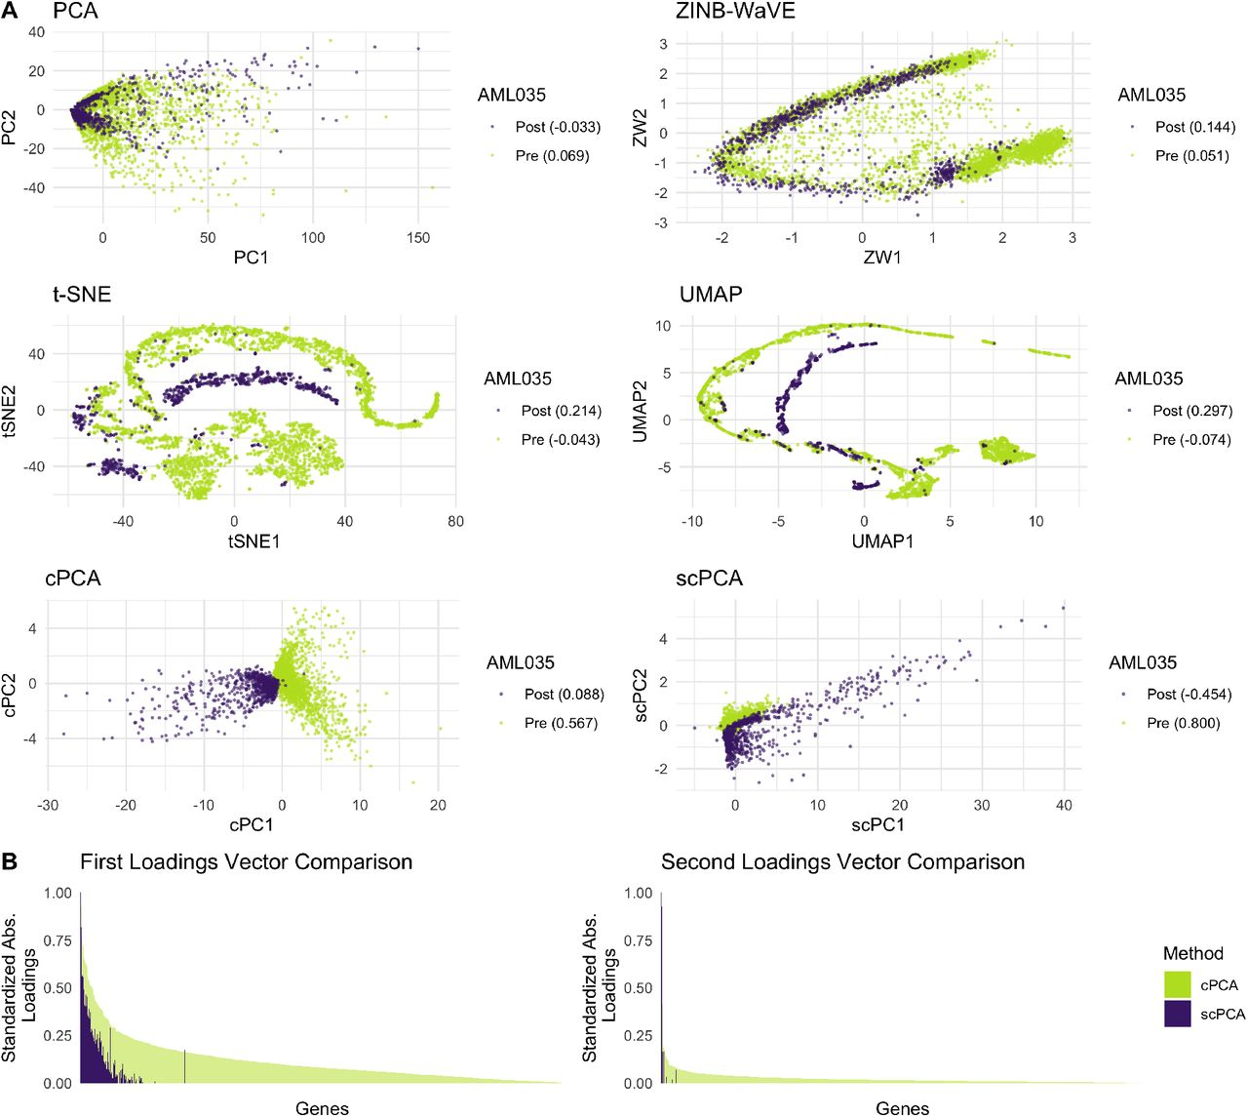
Graphical Analysis

Slide 29
Results and Observations
Of the seven dimensionality reduction methods applied to Patient 035’s data (Figures 3A and S8), cPCA and scPCA best capture the biologically meaningful information relating to treatment status. Each produces linearly separable clusters corresponding to pre- and post-treatment cells; scPCA’s projection yields a tighter cluster of pre-transplant cells when compared to that produced by cPCA, and the opposite is true regarding the clusters of post-transplant cells. Additionally, scPCA’s projection required considerably less information, even though its results are analogous to cPCA’s: 176 genes and 17 genes have non-zero entries in, respectively, the first and second columns of the loading matrix produced by scPCA (Figure 3B). In general, the leading loading vectors of cPCA and scPCA place an increased importance on the same genes. Genes with non-zero loadings in scPCA’s first and second loading vectors were also subjected to a gene set enrichment analysis to uncover their roles in biological processes; details and results are presented in Table S4. Regarding the other methods’ results, PCA, t-SNE, and SIMLR fail to separate the pre- and post-transplant cells, and UMAP’s and ZINB-WaVE’s embeddings resemble a trajectory more closely than they do a set of clusters.

Slide 30
Results and Observations
Similarly to Patient 035’s results, the two-dimensional embeddings of Patient 027’s data produced by PCA, t-SNE, UMAP, SIMLR, and ZINB-WaVE do not contain distinct clusters of pre- and post-transplant BMMCs S9; however, cPCA and scPCA generate low-dimensional representations of the data in which samples are clustered based on treatment status. Although cPCA’s representation produces denser, more distinct groupings, the first two columns of scPCA’s loading matrix contain non-zero values in only five genes, STMN1, CA1, LDHA, PDLIM1, and C1QBP. The first four genes have been linked to leukemia [22, 24, 34, 13], and the last gene, C1QBP, is responsible for a protein that plays a critical role in tumor metabolism [1].

Slide 31
Conclusion
We have proposed a novel dimensionality reduction technique for use with high-dimensional biological data: sparse contrastive principal component analysis. A central contribution of the method is the incorporation of a penalization step that ensures both the sparsity and stability of the principal components generated by contrastive PCA. Our approach allows for high-dimensional biological datasets, such as those produced by the currently popular scRNA-seq experimental paradigm, to be examined in a manner that uncovers interpretable as well as relevant biological signal after the removal of unwanted technical variation, all the while placing only minimal assumptions on the data-generating process.
We also present a data-adaptive and algorithmic framework for applying contrastive dimensionality reduction techniques, like cPCA and scPCA, to high-dimensional biological data. Where the original proposal of cPCA relied upon visual inspection by the user in selecting the “best” contrastive parameter [2], an unreliable process, our extension formalizes the data-adaptive selection of tuning parameters. The automation of this step translates directly to significantly increased computational reproducibility. We have proposed the use of cross-validation to select tuning parameters from among a pre-specified set in a generalizable manner, using average silhouette width to assess clustering strength. Several other approaches to the selection of tuning parameters, including the choice of criterion for assessing the “goodness” of the dimensionality reduction (here, clustering strength as measured by the average silhouette width), may outperform our approach in practice and could be incorporated into the modular framework of scPCA; we leave the development of such approaches and assessment of their potential advantages as an avenue for future investigation.

Slide 32
Conclusion
We have demonstrated the utility of scPCA relative to competing approaches, including standard PCA, cPCA, t-SNE, UMAP, and, where appropriate, ZINB-WaVE and SIMLR, using both a simulation study of single-cell RNA-seq data and the re-analysis of several publicly available datasets from a variety of high-dimensional biological assays. We have shown that scPCA recovers low-dimensional embeddings similar to cPCA, but with a more easily interpretable principal component structure and, in simulations, diminished technical noise. Further, our results indicate that scPCA generally produces denser, more relevant clusters than t-SNE, UMAP, SIMLR, and ZINB-WaVE. Moreover, we verify that clusters derived from scPCA correspond to biological signal of interest. Finally, as the cost of producing high-dimensional biological data with high-throughput experiments continues to decrease, we expect that the availability and utility of techniques like scPCA – for reliably extracting rich, sparse biological signals while data-adaptively removing technical artifacts – will strongly motivate the collection of control samples as a part of standard practice.

Slide 33
Bibliography
[1].↵(2010). Mitochondrial p32 protein is a critical regulator of tumor metabolism via maintenance of oxidative phosphorylation. Molecular and cellular biology, 30(6), 1303–1318.Abstract/FREE Full TextGoogle Scholar[2].↵Abid, A., Zhang, M. J., Bagaria, V. K., and Zou, J. (2018). Exploring patterns enriched in a dataset with contrastive principal component analysis. Nature Communications, 9(1), 2134.Google Scholar[3].↵Amir, E. A. D., Davis, K. L., Tadmor, M. D., Simonds, E. F., Levine, J. H., Bendall, S. C., Shenfeld, D. K., Krishnaswamy, S., Nolan, G. P., and Pe’Er, D. (2013). ViSNE enables visualization of high dimensional single-cell data and reveals phenotypic heterogeneity of leukemia. Nature Biotechnology, 31(6), 545–552.CrossRefPubMedGoogle Scholar[4].↵Becht, E., McInnes, L., Healy, J., Dutertre, C. A., Kwok, I. W., Ng, L. G., Ginhoux, F., and Newell, E. W. (2019). Dimensionality reduction for visualizing single-cell data using UMAP. Nature Biotechnology, 37(1), 38–47.Google Scholar[5].↵Cardozo, D. M., Moliterno, R. A., Sell, A. M., Guelsin, G. A. S., Beltrame, L. M., Clementino, S. L., Reis, P. G., Alves, H. V., Mazini, P. S., and Visentainer, J. E. L. (2014). Evidence of HLA-DQB1 contribution to susceptibility of dengue serotype 3 in dengue patients in Southern Brazil. Journal of Tropical Medicine, 2014.Google Scholar[6].↵Castañeda, D. M., Salgado, D. M., and Narváez, C. F. (2016). B cells naturally induced during dengue virus infection release soluble CD27, the plasma level of which is associated with severe forms of pediatric dengue. Virology, 497, 136–145.Google Scholar[7].↵Fitzgerald, K. A. (2011). The interferon inducible gene: Viperin.Google Scholar[8].↵Fujiwara, T., Kwon, O.-H., and Ma, K.-L. (2020). Supporting analysis of dimensionality reduction results with contrastive learning. IEEE Transactions on Visualization and Computer Graphics, 26(1), 45–55.Google Scholar[9].↵Gagnon-Bartsch, J. A. and Speed, T. P. (2012). Using control genes to correct for unwanted variation in microarray data. Biostatistics, 13(3), 539–552.CrossRefPubMedWeb of ScienceGoogle Scholar[10].↵Gagnon-Bartsch, J. A., Jacob, L., and Speed, T. P. (2013). Removing unwanted variation from high dimensional data with negative controls. Berkeley: Tech Reports from Dep Stat Univ California, pages 1–112.Google Scholar[11].↵Gentleman, R., Carey, V., Huber, W., Irizarry, R., and Dudoit, S. (2006). Bioinformatics and computational biology solutions using R and Bioconductor. Springer Science & Business Media.Google Scholar[12].↵Gentleman, R. C., Carey, V. J., Bates, D. M., Bolstad, B., Dettling, M., Dudoit, S., Ellis, B., Gautier, L., Ge, Y., Gentry, J., et al. (2004). Bioconductor: open software development for computational biology and bioinformatics. Genome biology, 5(10), R80.CrossRefPubMedGoogle Scholar[13].↵Holleman, A., Cheok, M. H., den Boer, M. L., Yang, W., Veerman, A. J., Kazemier, K. M., Pei, D., Cheng, C., Pui, C.-H., Relling, M. V., Janka-Schaub, G. E., Pieters, R., and Evans, W. E. (2004). Gene-Expression Patterns in Drug-Resistant Acute Lymphoblastic Leukemia Cells and Response to Treatment. New England Journal of Medicine, 351(6), 533–542.CrossRefPubMedWeb of ScienceGoogle Scholar[14].↵Huber, W., Carey, V. J., Gentleman, R., Anders, S., Carlson, M., Carvalho, B. S., Bravo, H. C., Davis, S., Gatto, L., Girke, T., et al. (2015). Orchestrating high-throughput genomic analysis with bioconductor. Nature methods, 12(2), 115.Google Scholar[15].↵Johnstone, I. M. and Lu, A. Y. (2009). On consistency and sparsity for principal components analysis in high dimensions. Journal of the American Statistical Association, 104(486), 682–693. PMID: 20617121.CrossRefPubMedWeb of ScienceGoogle Scholar[16].↵Johnstone, I. M. and Paul, D. (2018). Pca in high dimensions: An orientation. Proceedings of the IEEE, 106(8), 1277–1292.Google Scholar[17].↵Kobak, D. and Linderman, G. C. (2019). Umap does not preserve global structure any better than t-sne when using the same initialization. bioRxiv.Google Scholar[18].↵Kwissa, M., Nakaya, H. I., Onlamoon, N., Wrammert, J., Villinger, F., Perng, G. C., Yoksan, S., Pattanapanyasat, K., Chokephaibulkit, K., Ahmed, R., and Pulendran, B. (2014). Dengue virus infection induces expansion of a CD14(+)CD16(+) monocyte population that stimulates plasmablast differentiation. Cell host & microbe, 16(1), 115–27.CrossRefPubMedWeb of ScienceGoogle Scholar[19].↵Leek, J. T. and Storey, J. D. (2007). Capturing heterogeneity in gene expression studies by surrogate variable analysis. PLoS genetics, 3(9), e161.Google Scholar[20].↵Lloyd, S. (1982). Least squares quantization in pcm. IEEE Transactions on Information Theory, 28(2), 129–137.CrossRefWeb of ScienceGoogle Scholar

Slide 34
[21].↵Lopez, R., Regier, J., Cole, M. B., Jordan, M. I., and Yosef, N. (2018). Deep generative modeling for single-cell transcriptomics. Nature Methods, 15(12), 1053–1058.Google Scholar[22].↵Machado-Neto, J. A., Saad, S. T. O., and Traina, F. (2014). Stathmin 1 in normal and malignant hematopoiesis. BMB reports, 47(12), 660–5.Google Scholar[23].↵McInnes, L., Healy, J., and Melville, J. (2018). UMAP: Uniform Manifold Approximation and Projection for Dimension Reduction.Google Scholar[24].↵Menteşe, A., Erkut, N., Demir, S., Özer Yaman, S., Sümer, A., Dogramaci, S., Alver, A., and Sönmez, M. (2017). Autoantibodies Against Carbonic Anhydrase I and II in Patients with Acute Myeloid Leukemia TT - Akut Miyeloid Lösemi Hastalarında Karbonik Anhidraz I ve II Otoantikorları. Turkish journal of haematology: official journal of Turkish Society of Haematology, 34(4), 307–313.Google Scholar[25].↵Nguyen, L. H. and Holmes, S. (2019). Ten quick tips for effective dimensionality reduction. PLOS Computational Biology, 15(6), 1–19.Google Scholar[26].↵R Core Team (2019). R: A language and environment for statistical computing.Google Scholar[27].↵Ringner, M. (2008). What is principal component analysis?. Nature biotechnology, (3), 303.Google Scholar[28].↵Risso, D., Ngai, J., Speed, T. P., and Dudoit, S. (2014). Normalization of rna-seq data using factor analysis of control genes or samples. Nature biotechnology, 32(9), 896.CrossRefPubMedGoogle Scholar[29].↵Risso, D., Perraudeau, F., Gribkova, S., Dudoit, S., and Vert, J. P. (2018). A general and flexible method for signal extraction from single-cell RNA-seq data. Nature Communications, 9(1).Google Scholar[30].↵Severson, K. A., Ghosh, S., and Ng, K. (2019). Unsupervised learning with contrastive latent variable models. Proceedings of the AAAI Conference on Artificial Intelligence, 33, 4862–4869.Google Scholar[31].↵Shen, D., Shen, H., and Marron, J. (2013). Consistency of sparse pca in high dimension, low sample size contexts. Journal of Multivariate Analysis, 115, 317–333.Google Scholar[32].↵van der Maaten, L. and Hinton, G. (2008). Visualizing data using t-sne.Google Scholar[33].↵Wang, B., Zhu, J., Pierson, E., Ramazzotti, D., and Batzoglou, S. (2017). Visualization and analysis of single-cell rna-seq data by kernel-based similarity learning. Nature Methods, 14(4), 414–416.Google Scholar[34].↵Wang, Y.-H., Israelsen, W. J., Lee, D., Yu, V. W. C., Jeanson, N. T., Clish, C. B., Cantley, L. C., Vander Heiden, M. G., and Scadden, D. T. (2014). Cell-state-specific metabolic dependency in hematopoiesis and leukemogenesis. Cell, 158(6), 1309–1323.CrossRefPubMedGoogle Scholar[35].↵Yu, B. (2013). Stability. Bernoulli, 19(4), 1484–1500.Google Scholar[36].↵Zappia, L., Phipson, B., and Oshlack, A. (2017). Splatter: simulation of single-cell RNA sequencing data. Genome Biology, 18(1), 174.CrossRefGoogle Scholar[37].↵Zhang, Z. H., Jhaveri, D. J., Marshall, V. M., Bauer, D. C., Edson, J., Narayanan, R. K., Robinson, G. J., Lundberg, A. E., Bartlett, P. F., Wray, N. R., and Zhao, Q.-Y. (2014). A comparative study of techniques for differential expression analysis on rna-seq data. PLOS ONE, 9(8), 1–11.CrossRefPubMedGoogle Scholar[38].↵Zheng, G. X. Y., Terry, J. M., Belgrader, P., Ryvkin, P., Bent, Z. W., Wilson, R., Ziraldo, S. B., Wheeler, T. D., McDermott, G. P., Zhu, J., Gregory, M. T., Shuga, J., Montesclaros, L., Underwood, J. G., Masquelier, D. A., Nishimura, S. Y., Schnall-Levin, M., Wyatt, P. W., Hindson, C. M., Bharadwaj, R., Wong, A., Ness, K. D., Beppu, L. W., Deeg, H. J., McFarland, C., Loeb, K. R., Valente, W. J., Ericson, N. G., Stevens, E. A., Radich, J. P., Mikkelsen, T. S., Hindson, B. J., and Bielas, J. H. (2017). Massively parallel digital transcriptional profiling of single cells. Nature Communications, 8(1), 14049.Google Scholar[39].↵Zou, H. and Hastie, T. (2018). elasticnet: Elastic-Net for Sparse Estimation and Sparse PCA. R package version 1.1.1

Slide 35
Implementation strategy
The scPCA technique will be tested on a simulated scRNA-seq dataset generated with the Splat framework.
The BMMCs of two healthy individuals from the publicly available dataset (Healthy 1: 1,985 cells; Healthy 2: 2,472 cells) will be used to generate a control dataset.
cPCA, SPCA and scPCA libraries will be needed for the implementation.
Implementation will be done for the same PCA methods and the outputs will be compared.

Slide 36
Thank You

